Slide 1
Food chain
Yao zhao

Slide 2
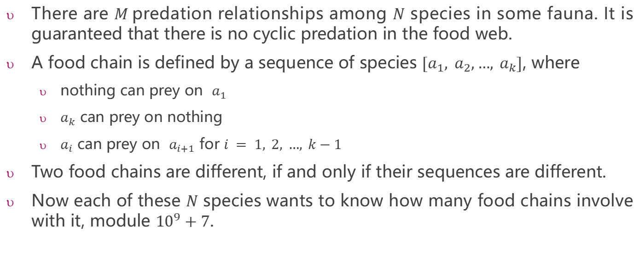
Food chain
There are $M$predation relationships among $N$ species in some fauna. It is guaranteed that there is no cyclic predation in the food web.
A food chain is defined by a sequence of species $[a_{1}, a_{2},…, a_{k}]$, where
nothing can prey on $a_{1}$
$a_{k}$ can prey on nothing
$a_{i}$ can prey on $a_{i+1}$ for $i = 1, 2, …, k−1$
Two food chains are different, if and only if their sequences are different.
Now each of these $N$ species wants to know how many food chains involve with it, module ${10}^{9}+7$.

Slide 3
Sample Input 1
species | food chains | number
1 | [2,3,1] [2,4,3,1] [2,4,5,1] | 3
2 | [2,3,1] [2,4,3,1] [2,4,5,1] | 3
3 | [2,3,1] [2,4,3,1] | 2
4 | [2,4,3,1] [2,4,5,1] | 2
5 | [2,4,5,1] | 1
5 6
4 5
4 3
2 4
3 1
2 3
5 1
1
3
2
5
4
Sample Output 1
3 3 2 2 1

Slide 4
species | food chains | number
1 | [7,5,1] | 1
2 | [2,4] [2,3,4] [2,6] [2,3,6] | 4
3 | [2,3,4] [2,3,6] | 2
4 | [2,4] [2,3,4] | 2
5 | [7,5,1] | 1
6 | [2,6] [2,3,6] | 2
7 | [7,5,1] [7,8] | 2
8 | [7,8] | 1
Sample Input 2
1
6
8 8
2 4
7 5
3 4
3 6
2 6
7 8
2 3
5 1
3
5
2
8
4
7
Sample Output 2
1 4 2 2 1 2 2 1

